Slide 1
Fundamentals of Machine Learning Week 7: Unsupervised learning Working on final project
Jonas Moons
All images are either own work, public domain, CC-licensed or fair use
Credits on last slide

Slide 2
Program
Unsupervised learning / clustering (k-means)
Explanation poster presentations

Slide 3
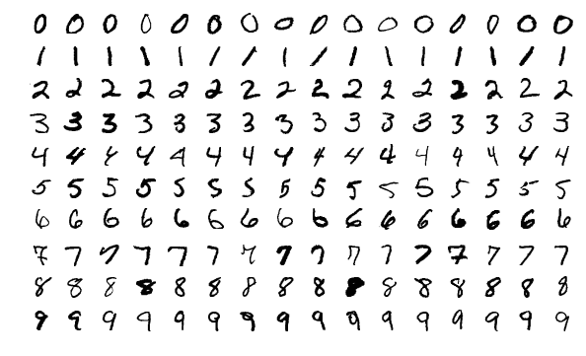
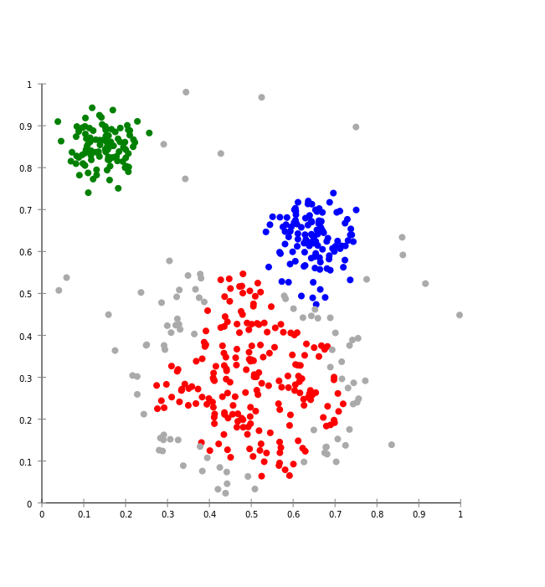

Supervised vs. unsupervised learning
Supervised: use known patterns to predict new cases
Handwriting recognition
Unsupervised: you let the algorithm discover patterns/clusters on its own
Spotify Radio / Discover Weekly
MNIST data set

Slide 4
Why clustering?
To discover interesting and useful clusters in the data and adapt our content or marketing strategy
For instance, different user types based on behavior (user profiling), e.g.
Explicit: likes, favorites, ratings, comments, etc.
Implicit: pages visited, content seen, mouse movements, etc.

Slide 5
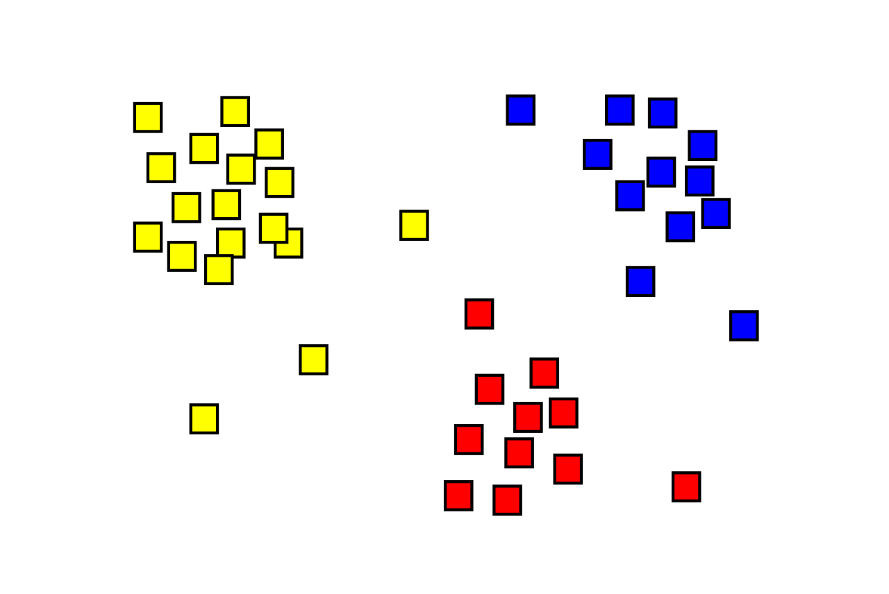
What is clustering?
Assign observations to several clusters
It’s not always clear which solution is ‘correct’
There are many algorithms; we will use k-means (simple to understand but often suboptimal)
Remember: shown as 2-dimensional here but n-dimensional in reality, n being the number of variables used

Slide 6
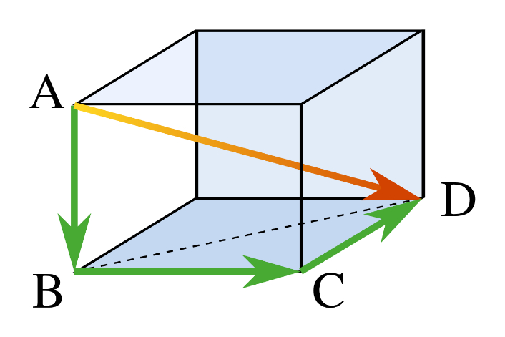
Distance
Each user is represented by a point in space
Each item (movie) is a dimension
The distance between two users can be calculated for any number of dimensions/movies (shown: 3)
User | Movie 1 | Movie 2 | Movie 3
1 | 5 | 3 | 5
2 | 4 | 1 | 2

Slide 7
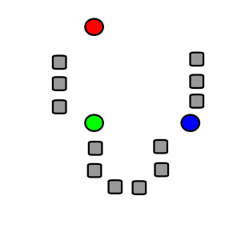
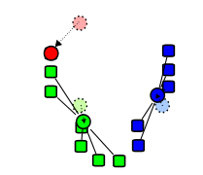
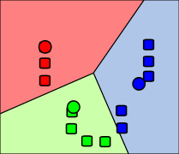
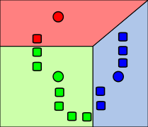
k-means algorithm
1. Start with k cluster centers at random
2. Assign each observation to nearest center
3. Move cluster centers to center of observations
4. Repeat until stable

Slide 8
K-means clustering

Slide 9
Exercise: clustering Iris data set
In this exercise, you will explore the logic of clustering using the famous Iris data set. See the Exercise folder for the data set (iris.csv), and the Notebook k-means in the Examples folder.
Read in the csv file.
Using a Seaborn scatterplot, plot the Iris data set with petal length on the x-axis and sepal length on the y-axis. Plot the different Iris species with a different symbol (see the Seaborn documentation).
What possible clusters do you see with the naked eye? How do they relate to the three species?
Using k-means clustering with 3 clusters (using only petal length and sepal length as X variables), create a new variable cluster and use this to make another scatterplot, using color for cluster.
How does k-means perform?
Try out different numbers of clusters to see what happens. What seems like the ‘natural’ number of clusters for this data set?

Slide 10
Problems with k-means
k-means can only make Voronoi cells (straight lines)
Suitable number of clusters often hard to determine in practice

Slide 11
Academic poster presentation
For us and other students / lecturers who may be interested
Thursday 23 January
14:30 setting up
14:45-15:45 presenting + feedback (switch roles after half an hour)
Vertical A1 format (you can combine 4 A3 if you want to save money/hassle)
In color. With some pretty graphs.
You will get a tip from your lecturer by e-mail

Slide 12
Format
Introduction: in which you define the context, the research question and the practical relevance
Data set: in which you explain how you acquired the data, and show your data cleaning steps
Feature engineering: in which you explain which transformations you have made to make your variables more informative (e.g., calculating number of days from a starting date)
Descriptive analysis: in which you show relevant graphs, tables and numbers with respect to your problem
Predictive model: in which you explain which analysis you have chosen and why. In which you build a relevant statistical model or train a machine learning algorithm.
Evaluation: in which you evaluate the model: numerically, qualitatively and in terms of practical value.

Slide 13
Peer groups
In groups of 4 (5 min. each):
Briefly summarize your project and its present state
What are your challenges?
Receive feedback
State your goal for today
Check-in at 11:30h

Slide 14
Check-in (11:30h)
Get together, discuss progress & problems (15 min.)

Slide 15
Image credit
Pythagoras by CheCheDaWaff (CC-BY-SA)
K-means algorithm pictures by Weston.pace (CC-BY-SA)
K-means gif by Chire (CC-BY-SA)

